Slide 1
Project Energy for All
Dheeraj Bandaru
Lorenzo Daviddi
Chiara Del Giudice

Slide 2


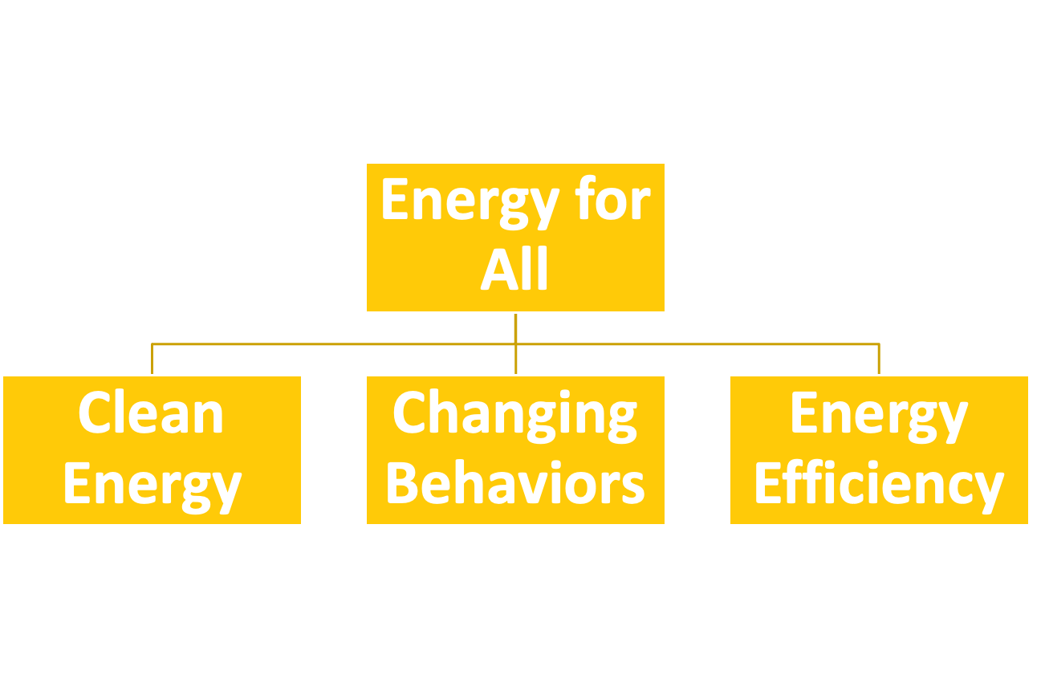
Project Overview
provides energy education in the southeast
first program is energy for all that focuses on the Eco District
SEEI
Goal of the project

Slide 3

Two Sections
EDUCATIONAL
FRIDGE FLIP
SCHOOLS
ADULTS
TRIAL RUN
FULL SCALE RUN

Slide 4
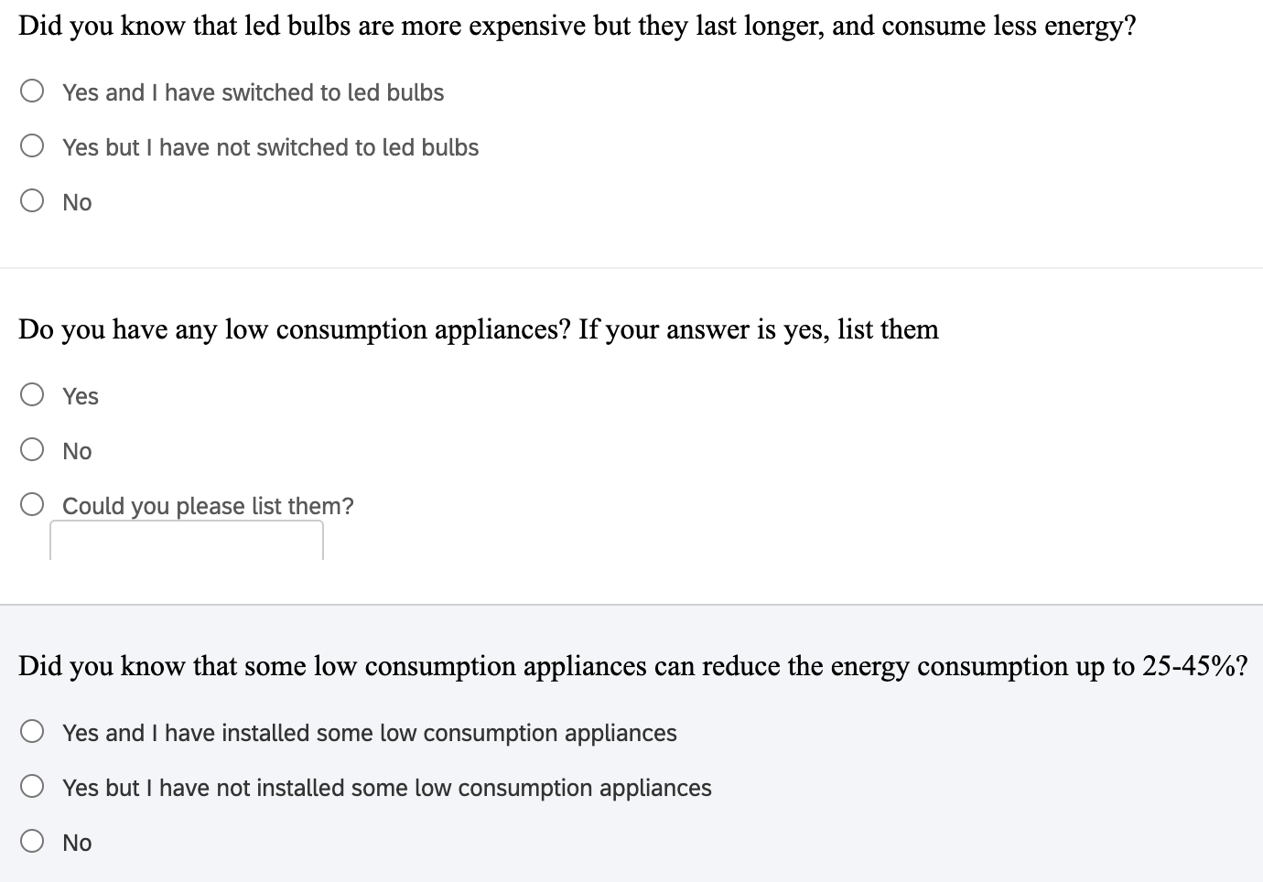
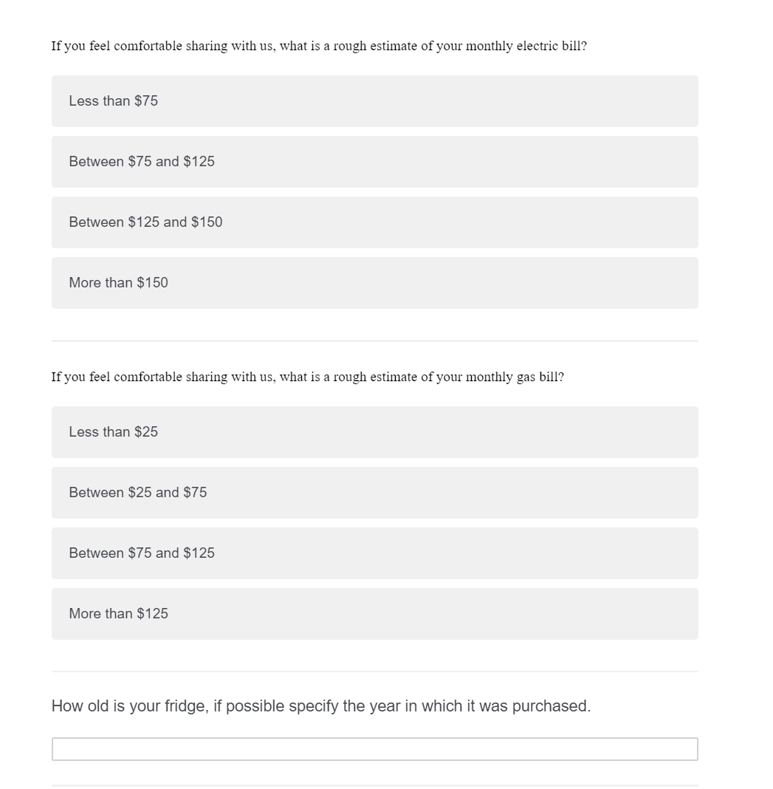
Survey
Notes:
awareness about energy efficiency of the member of the community

Slide 5
Education Plan: Primary and Middle School
Materials:
  NEED (National Energy Education Development) Project curricula
  SEEI materials
Different levels of complexity to maximize learning
Possibility to obtain financing through NEED’s Classroom Grant Programs to expand the schools’ energy education units
Classroom activities on a variety of energy efficiency related topics

Slide 6
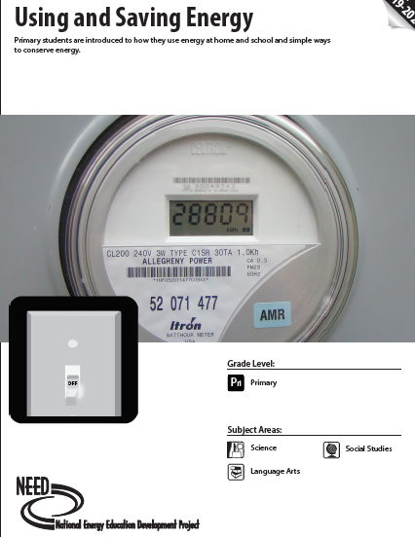
NEED Curricula: Example
Grade level: Primary School, K-1
Time: 10-12 30 minute sessions
Teacher guide, theoretical content, worksheets, hands-on activities

Slide 7
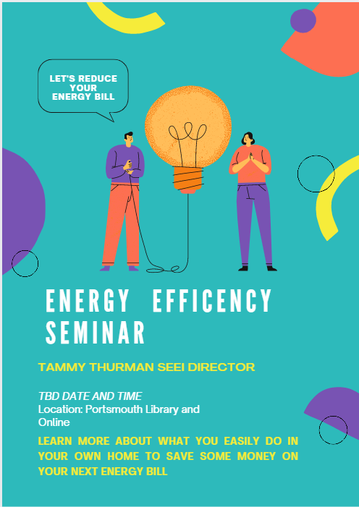
Education Plan: Adults
Two events focusing on the importance and benefits of energy efficiency
Speaker: Tammy Thurman - SEEI Director
Hybrid modality
Location: Portsmouth Library
    Cradock Branch
    Manor Branch
Presentation of the Fridge Flip Initiative

Slide 8
Going Forward
Seminars about the opportunities available to individuals to obtain rebates and incentives
Examples of initiatives available in Virginia: Weatherization Assistance Program (Virginia Department of Housing and Community Development), Income & Age Qualifying Home Improvements and EnergyShare (Dominion Energy), ...

Slide 9

Fridge Flip
Goal:
Replace old inefficient fridges with newer, more efficient fridges to help reduce energy costs for individual households and use the savings to pay for these upgrades
Rules for Participation:
Agrees to pay back the organization on a monthly basis based on savings
Agrees to follow our changing energy behaviour guidelines and work on an individual level to create savings
Agrees to give the organization, for disposal, their old fridge
  Fast Free Appliance Removal Virginia Beach
Notes:
https://www.fastfreeapplianceremoval.com/virginia-beach-virginia.html#:~:text=Call%20us%20at%20757%2D383,surrounding%20cities%20In%20Southeastern%20Virginia

Slide 10
Two Stage Process
Trial Run
Full Scale Run
Conducted with 10 households with fridges from 1990-1992 to assess true energy savings and reasonable rates for the payback protocol
Funded by Home Depot with their 5000 dollar store credit
Will be monitoring participants electricity bills
No cost to participants will be fully covered by the Home Depot Credit
Conducted with ~1000 households that are recruited from the Hampton Roads area
Funded with a loan of $500,000 from the VA Saves program
Will be referencing the trial run results to recruit participants

Slide 11
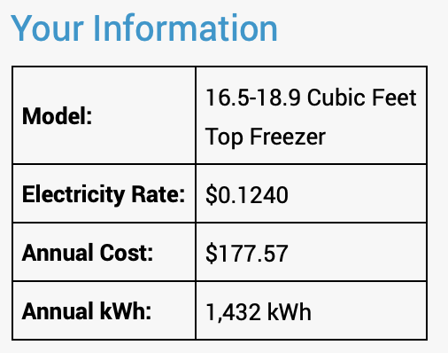

Trial Run
Initial Investment: $483.327
Energy Usage per Year: 398 KWH
Cost per Year: 398 x 0.1240 = $49.35
Current Cost per Year: $177.57
Yearly Savings: 177.57 - 49.35 = $128.22
Over 5 years: $641.10
Five-Year ROI: (641.10 - 83.327)/483.327 = = 32.64%
Notes:
feasibility of the project and to have some real numbers in order to make people understand that this initiative is valid

Slide 12
Scaling Up
Geographic
This model can be easily be expanded to other regions with similar issues to the Eco-District
  Key Demographics to look for
    Ageing Population
    Low Income Population
    Minimal population growth over the past couple years
Potential Geographic regions with demographics that are similar to the Eco-District are very abundant and we would have to find corresponding loan programs like VA Saves
Scope
This model can also be implemented for other appliances
    Washers and Dryers
    Heating and Cooling systems
    Dishwashers
    Microwaves
    Televisions
    Toilets
Some of these appliances swaps could also save on more than just the energy usage, for example swapping out toilets could save water as well

Slide 13






UN SDGs Connection

Slide 14
Questions?

Slide 15
Thank You!

